Slide 1

AT&T Customer Churn Reduction and Increasing Revenue through CLTV
SEM 6 TEAM 7
Clifford Choo Sing Link (U2011513B)
David Alexander Yosal (U2010520B)
Lim Qing Rui (U2010816G)
Low Yong Zhuo (U1911161B)
Shao Yakun (U1920578C)

Slide 2
Table of contents
01
02
Introduction and Objectives
Key Trends in Data
03
04
Business Problem and Analysis
Recommendations and Conclusions
Overview of AT&T
Visualisation of Data
The Project Problem Statements
Strategies for AT&T
Presenter: Qing Rui

Slide 3

AT&T’s company overview
1
27% Market Share in USA
2
5G penetration across 12 major USA cities in 2018
3
Primary Cause of Churn related to Customer Service Issues
4
Increased competition from smaller mobile competitiors aside larger brand names (T-mobile, Verizon)
Presenter: Qing Rui
Notes:
5G provides tailwinds to capture customer value

Slide 4

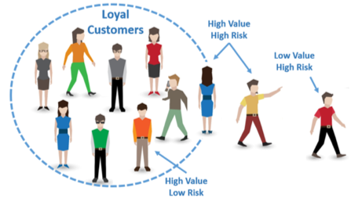

Business Opportunity
Business Opportunity
Average annual Churn rate in the telecommunications industry is 21%, leverage on Machine Learning to reduce Churn and improve CLTV
Our Objectives
Identify services that can improve Churn Outcome
Predict Variables that are highly linked to Churn Score
Increasing CLTV through improving factors for customer acquisition and retention
Presenter: Qing Rui
Notes:
example of higher churn score would be customers with increasing service requests being linked to a higher probability of Churn, and hence AT&T can implement strategies for a seamless customer journey or experience

Slide 5
Our Business Objectives
Identify services that can improve Churn Outcome
Predict Variables that are highly linked to Churn Score
Increasing CLTV through improving factors for customer acquisition and retention
Explorative analysis and visualizations to determine factors leading to higher Churn or feasible product implementations
Compare current and future services in policy and decision making to provide greater business values to customer
Presenter: Qing Rui
Notes:
example of higher churn score would be customers with increasing service requests being linked to a higher probability of Churn, and hence AT&T can implement strategies for a seamless customer journey or experience

Slide 6
Our Business Objectives
Identify services that can improve Churn Outcome
Predict Variables that are highly linked to Churn Score
Increasing CLTV through improving factors for customer acquisition and retention
Risk assessment of current business decisions leading to higher Churn and evaluation of current services to produce customer retention strategies
Intervention points of their current service packages and development of improvement plans
Presenter: Qing Rui
Notes:
example of higher churn score would be customers with increasing service requests being linked to a higher probability of Churn, and hence AT&T can implement strategies for a seamless customer journey or experience

Slide 7
Our Business Objectives
Identify services that can improve Churn Outcome
Predict Variables that are highly linked to Churn Score
Increasing CLTV through improving factors for customer acquisition and retention
Customer acquisition compared to customer retention is 5 to 25x costlier
Expenditure of current customers is greater than newer customers
Increment of revenue from higher CLTV customers to minimize acquisition cost and understand factors leading to higher customer expenditure
Presenter: Qing Rui
Notes:
example of higher churn score would be customers with increasing service requests being linked to a higher probability of Churn, and hence AT&T can implement strategies for a seamless customer journey or experience

Slide 8
Strengthening the need to address the Gap
01
02
03
Pivoting towards customer centric business models and reducing cost of Churn
Rise in investors concerns about profitability
Churn and Service purchased as business performance indicators
Data analytics to understand customer constraints potentially achieving additional 60% profits
80% of AT&T Income derived from Telco Service, hence optimization of current service will lead to improvements in profit forecastability and growth in customer service
Telco Services and Customer demography are used as factors influencing Churn and Business performance. Appropriate mix of services and products can lead to lower churn and greater number of services purchased
Desired Outcome:
Using a data-driven approach to determine key objectives contributing to overall churn and increasing CLTV while explaining key trends in consumer preferences and behaviors for marketing and service strategies
Presenter: Qing Rui

Slide 9
Key trends in our Data
Here you can describe the topic of the section
Significance and difference in correlations between Churn, CLTV and attrition factors
Presenter: Qing Rui

Slide 10
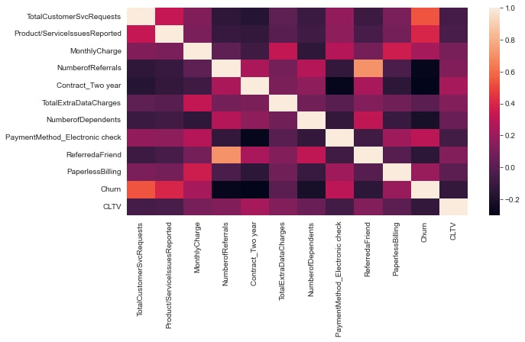
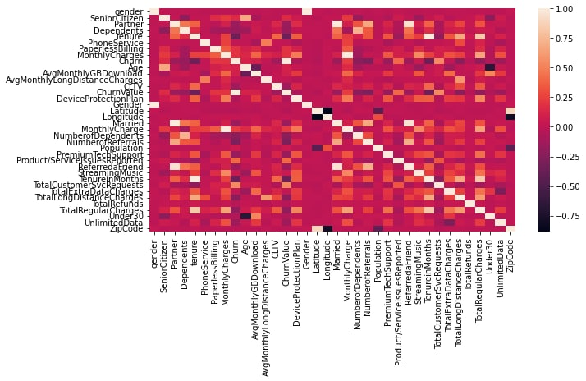
Correlation of Services and Data
Expenditure of Consumers positively correlated with tenure with AT&T
Churn has a high correlative direction towards Service Requests signalling better customer service as a differentiating factor
Tenure, total long-distance charges and total regular charges are strong direct influences of the revenue (CLTV) obtainable by AT&T with strong correlations
Presenter: Qing Rui

Slide 11
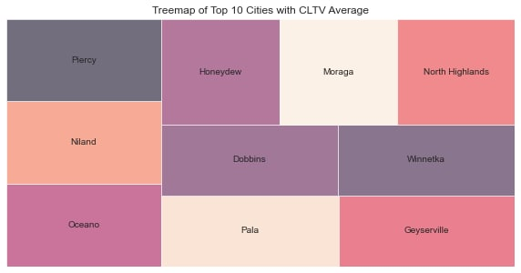
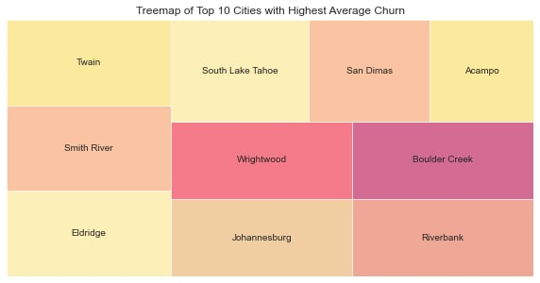
Geospatial data with Churn and CLTV
Top 10 Cities with Highest CLTV
Top 10 Cities with Highest Churn
In the top 10 cities for CLTV, AT&T can focus on implementing services that results in a higher expenditure from residents in these areas to generate higher revenue
Churn reduction analysis can be performed in these cities to determine reasons for customer attrition, such as competitors or dissatisfactory customer service.
Presenter: Qing Rui
Notes:
Churn reduction analysis using factors pointed out from our models

Slide 12
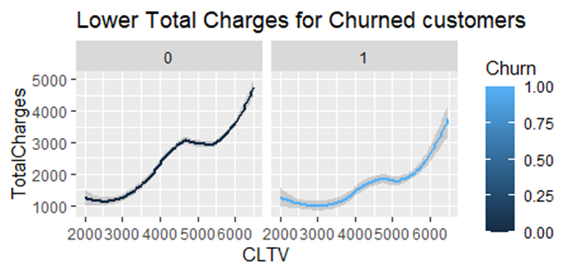
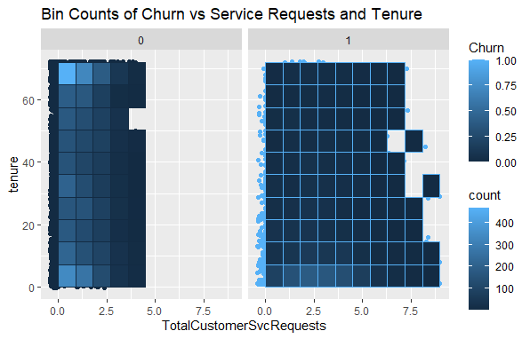
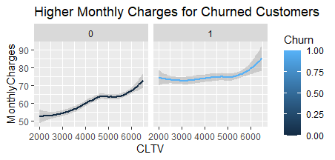
Churn as an Indicator
Equal distribution of service requests amongst churn and tenure
Customers with Churn displayed greater amount of service requests at all tenure durations
Total Charges with Churn customers are higher→ AT&T can focus on these areas to determine why little churn occurs
Churn customers show higher Monthly Charges which is unfair→ Possible price sensitivity
Presenter: Qing Rui
Notes:
The pricing of services for customers in this area is not justifiable given the lower total charges for churn customers.

Slide 13
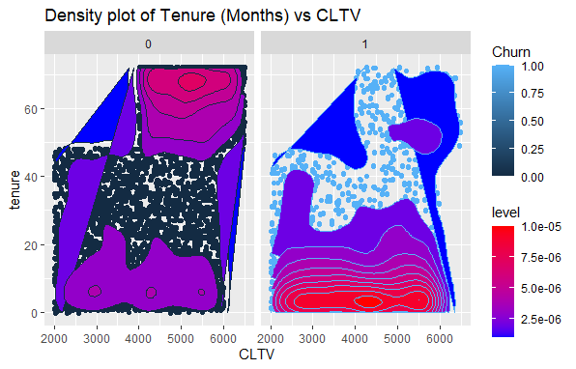
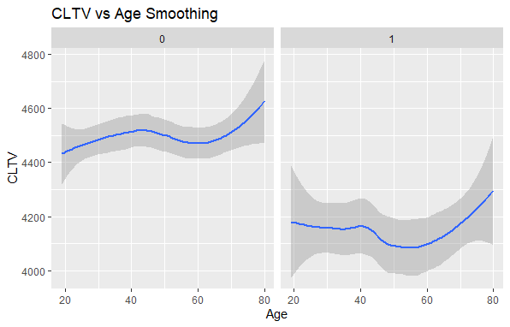
Trends in CLTV
Pivoting towards customer centric business models and reducing cost of Churn
You can explain your product or your service
Customers with Churn Outcomes display lower tenures (Months < 1) and lower CLTV on average.
Customers without Churn display high concentrations at extreme tenure durations and should be AT&T can focus on investigating methods to increase tenures at lower churn outcomes (red box).
Churn value decreases after age of 40 years old (orange box), and AT&T can focus less on customer acquisition within this age group
Presenter: Qing Rui

Slide 14
Business Problem #1
Which services we can group together?
Presenter: David

Slide 15
Solutions Methodology and Analytics Tools Used
Tools Used
apriori algorithm from the mlxtend’s library
Sliced the dataset by service categories and churn type
Create the association rules using apriori and pick out noticeable rules
Turning those findings into recommendations
Classifies all services into 3 main service types: internet, phone and others. Then sliced the data further into all cases, only cases where churn == 1 and churn == 0
Ran the apriori algorithm to all permutations of the dataset, with minimum support and confidence of 0.4, then sort the rules by lift. Interesting rules need to be significant (lift != 1.0)
Translating findings into the contextual scenario and try to find ways we can value add AT&T from those findings
Presenter: David

Slide 16
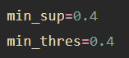
Association Rules
item_all = apriori(assoc_rule_data_all, use_colnames=True, min_support=min_sup)
assoc_rule_all = association_rules(item_all, metric = 'confidence', min_threshold=min_thres)
Model Parameters
Rules Evaluation
>The threshold for both support and confidence is 0.4.
>This means that all the rules have at least > 0.4 support and confidence
>This is to prune out the irrelevant rules
>Lift is the main metric that we look out for when combing through all the rules created
>We disregarded any rules that have lift = 1.0 or any that is only slightly above / below 1.0
Presenter: David

Slide 17
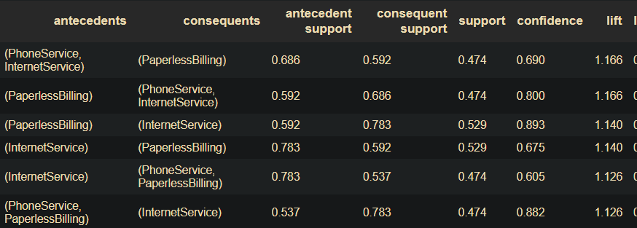
Noticeable associations from all services
InternetService, PaperlessBilling and PhoneService are heavily connected to each other, UNLESS InternetService → PhoneService and vice versa
Customers subscribed to phone service is likely to get multiple lines
Presenter: David

Slide 18
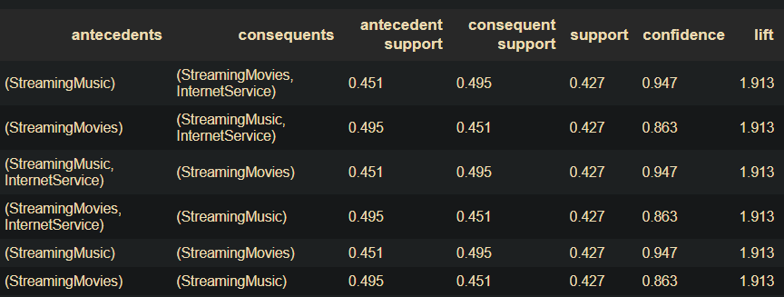
Noticeable associations from internet-related services
StreamingMusic, StreamingMovies and InternetService often grouped up together in rules that has a very high lift.
Presenter: David

Slide 19
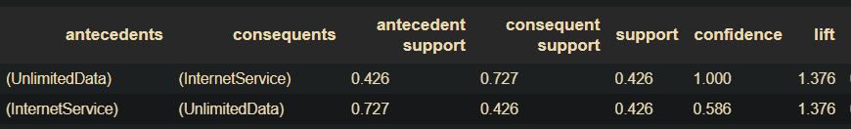
Comparing associations between customers who stay and left the company
In the dataset containing only cases where churn = 0, internet service and unlimited data are products that often bought together
!!!
However, this does not draw any conclusion between staying with the company and buying unlimited data
Presenter: David

Slide 20
Recommendations to AT&T based on findings
Product / Services Bundlings
Why do product bundling?
Simplify customer’s purchasing journey, increasing sales efficiency
A simplified and filtered down options (such as bundlings) increases the chance of customer subscribing to the additional service
Internet service and phone service
Internet service, streaming movies and streaming music
Phone service and multiple lines
Internet service and unlimited data
Why changing the default option?
Cost savings from omitting the need to print and mail bills
Increases customer satisfaction
Paperless billing as the default option
Presenter: David

Slide 21
Business Problem #2
Here you can describe the topic of the section
Predicting and Monitoring Customer Churn
Presenter: Yakun

Slide 22


Our Goal for Business Problem 2
a) Predict Customer Churn
- Accurately
- and with the least cost for a false prediction
b) Insights on factors affecting customer churn
Images reveal large amounts of data, so remember: use an image instead of a long text. Your audience will appreciate that
Presenter: Yakun

Slide 23
a) Develop a Good Churn Prediction Tool
3
Our Methodology
1
2
3
Test multiple ML models & compare performance
Optimize the model to match our business objective
Finalize our churn Prediction Tool
Choose the one with best performance
Presenter: Yakun

Slide 24


a) Develop a Good Churn Prediction Tool
3
1
Test multiple ML models & compare performance
4 Models
Logistic Regression, CART, Random Forest, XGBoost,
2
Optimize the model to match our business objective
5 Relevant Performance Metrics
1. Accuracy Score
2. Precision Score
3. Recall Score
4. ROC-AUC Score
5. F1 Score
3
Finalize our churn Prediction Tool
Presenter: Yakun

Slide 25
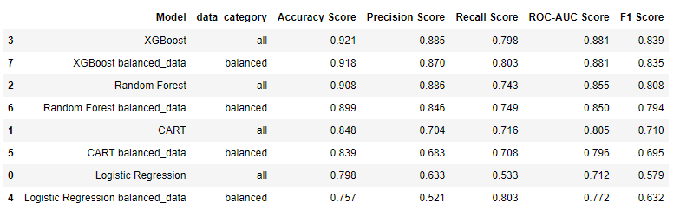

a) Develop a Good Churn Prediction Tool
3
Model Performance (Sorted)
1
Test multiple ML models & compare performance
2
Optimize the model to match our business objective
3
Finalize our churn Prediction Tool
XGBoost has the best performance
Presenter: Yakun

Slide 26
a) Develop a Good Churn Prediction Tool
3
Test multiple ML models & compare performance
Why is optimization needed here?
1
Basically, to improve our model’s performance to better meet our business objective:
2
Optimize the model to match our business objective
Better Accuracy
Least cost for a false prediction
Potentially increase the usability of model (e.g., reduced the no. of required inputs)
3
Finalize our churn Prediction Tool
Presenter: Yakun

Slide 27
a) Develop a Good Churn Prediction Tool
3
Test multiple ML models & compare performance
Brief overview of optimization process
1
Better Accuracy (“accuracy” metric)
Least cost for a false prediction
(“recall_score” metric – reduce FN predictions)
2
Optimize the model to match our business objective
Hyperparameter tuning
Scoring Metric: “accuracy” & “recall_score”
10-fold Cross Validation
3
Finalize our churn Prediction Tool
Presenter: Yakun

Slide 28
a) Develop a Good Churn Prediction Tool
3
Test multiple ML models & compare performance
Brief overview of optimization process
1
Better Accuracy
Potentially increase the usability of model (e.g., reduced the no. of required inputs)
)
2
Optimize the model to match our business objective
Feature selection
Feature importance ranked by “gain score
Top few variables are selected as input
3
Finalize our churn Prediction Tool
Presenter: Yakun

Slide 29
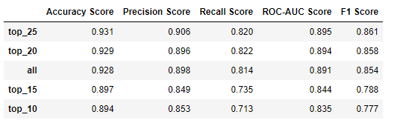
a) Develop a Good Churn Prediction Tool
3
Test multiple ML models & compare performance
Feature selection variation results
1
2
Optimize the model to match our business objective
3
Finalize our churn Prediction Tool
Top 25 as inputs has the best performance
Presenter: Yakun

Slide 30
a) Develop a Good Churn Prediction Tool
3
Test multiple ML models & compare performance
Our final churn prediction tool:
1
Optimized XGBoost
(using top 25 features as model inputs)
2
Optimize the model to match our business objective
This prediction tool satisfied our objective
Predict customer churn accurately & with the least cost for a false prediction
The tool is easy to use and readily accessible
3
Finalize our churn Prediction Tool
Presenter: Yakun

Slide 31


b) Helpful Insights for Monitoring Customer Churn
3
Other than just being able to predict the customer churn rate, we also want to enable you to…
Know what are the important factors contributing to higher probability of churn?
So that you can adjust your business strategies promptly and effectively to retain more customers!
Presenter: Yakun

Slide 32

b) Helpful Insights for Monitoring Customer Churn
3
How can we help you achieve this? (our methodology)
Using SHAP (SHapley Additive exPlanations) to zoom into our model, see how each factor contributes to churn prediction
Presenter: Yakun

Slide 33
b) Helpful Insights for Monitoring Customer Churn
3
How can we help you achieve this? (our methodology)
See the contribution of the factors relative to:
1. The entire factor group
2. Among the demographical factors
3. Among the billing-related factors
4. Among the service/products-related factors
Presenter: Yakun

Slide 34
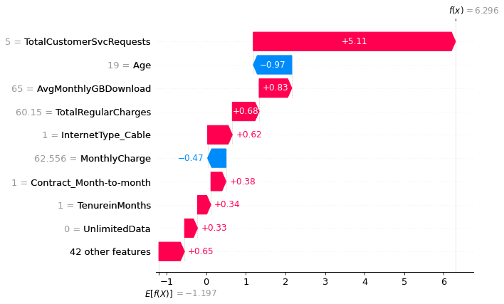

b) Helpful Insights for Monitoring Customer Churn(1)
Among all feature categories…
Total Customer Service Requests
has the highest contribution to churn
No. of Service Requests > 5
Should try to resolve issues faced than customers in less than 5 calls/requests
Probability of churn significantly
Well-trained customer service team is crucial
Presenter: Yakun

Slide 35
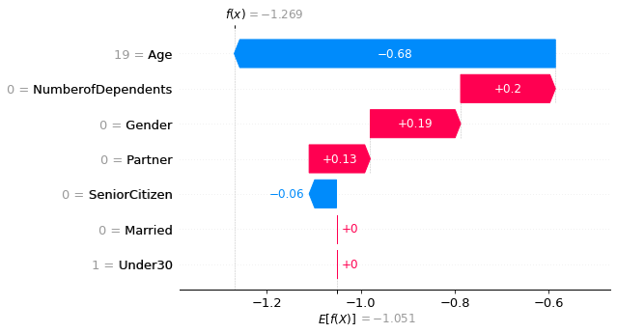

b) Helpful Insights for Monitoring Customer Churn(2)
Within the demographical variables…
Customer’s Age
has the highest contribution to churn
Age > 19
Can potentially review the current products/services, and evaluate what type of new and relevant services/contents can be brought to attract younger customer to stay
Probability of churn significantly
Presenter: Yakun

Slide 36
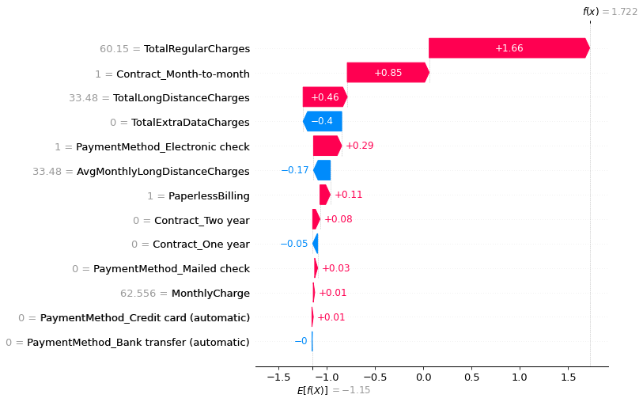

b) Helpful Insights for Monitoring Customer Churn(3)
Within the billing-related variables…
Total Regular Charge &
Month-to-Month Contract Period
has the highest contribution to churn
could consider providing special services or promotion to customers with high charges
Taking a Mth-to-Mth Contract
Probability of churn significantly
May consider introduce longer variations of contract length (e.g., 3month, half-year)
Compared to other contract periods
Presenter: Yakun

Slide 37
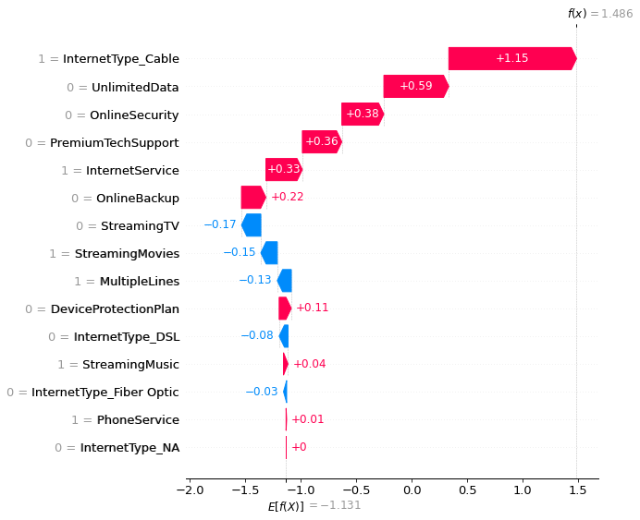

b) Helpful Insights for Monitoring Customer Churn(4)
Within the service-related variables…
Cable Internet Type
has the highest contribution to churn compared to other internet types
Could zoom into internet cable services and investigate if the customers are facing any significant problems with cables (vs other types), make improvements to reduce customer churn due to this
Using a cable internet
Probability of churn significantly
Compared to other internet types
Presenter: Yakun

Slide 38
Business Problem #3
Here you can describe the topic of the section
Which customers are more valuable to us?
Presenter: Clifford

Slide 39







Linear Regression
Customer Lifetime Value (CLTV)?
TenureinMonths + Married + Gender + ...... + Age
Presenter: Clifford

Slide 40
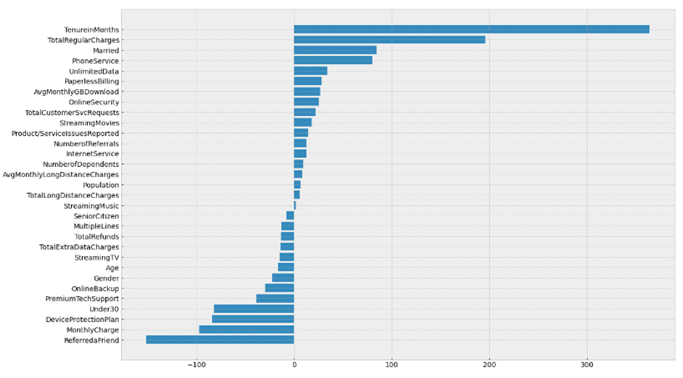
Feature Importance Analysis
Presenter: Clifford

Slide 41




Insight 1: Extend Tenure
Reasons
- 5x to 25x less costly to retain existing customers than acquiring new customers
- Longer tenure, more money spent
Tenure
CLTV
Opportunities
- Reduce new customer acquisition campaigns
- Customer centric approach -> garner feedback
Presenter: Clifford

Slide 42

Insight 2: Change Pricing Strategies
Total
Regular
Charges
Reasons
- Revenue metric: higher total charges in the long run leads to higher value
- Lower monthly charges in the short run attracts customers to stay
CLTV
Monthly
Charges
Opportunities
- Low cost-leadership strategy -> low initial costs to lock customers in
- May choose to raise prices after a while
Presenter: Clifford

Slide 43

Insight 3: Segment by Age
Reasons
- Different age groups have different preferences and different group profit margins
Age
CLTV
Opportunities
- Target the young with personalisation and bundling of services
- Target the old with stability, informational content, customer support
Presenter: Clifford

Slide 44
Recommendations and Dashboard Demo
Here you can describe the topic of the section
Short-term and Long-term Strategies
Presenter: Yong Zhuo (YZ)

Slide 45
Translating insights into Recommendations
To utilise the analytical tools and generate insights from the models, a dashboard is proposed to be implemented
Ease of convenience & accessibility to key information from the database as well as results & recommendations from the models produced
Allow real-time dynamic updates of prediction results & business insights from model outputs, based on a constantly updating customer database
Presenter: Yong Zhuo (YZ)

Slide 46

Improvement Strategies for AT&T
Short-Term Plan
Product/Service Bundling
Increase appeal to the Younger Generation
Long-Term Plan
Improve Customer Service Quality
Presenter: Yong Zhuo (YZ)

Slide 47
Short-Term Strategy
Product/Service Bundling
Filter key product/services that are more popular to increase sales efficiency & ensure a pleasant customer purchasing journey
Internet Services can be bundled with Phone Services, or co-bundled with Streaming Movies and music services.
Offer exclusive streaming services only for AT&T customers by tapping on the rising movie streaming trend propelled by the COVID-19 pandemic.
Presenter: Yong Zhuo (YZ)

Slide 48
Improvement Strategies for AT&T
Short-Term Plan
Product/Service Bundling
Improve Customer Service Quality
Long-Term Plan
Increase appeal to the Younger Generation
Presenter: Yong Zhuo (YZ)

Slide 49
Long-Term Strategy
Customer Service Quality
Younger Audience
Customer Service improvement trainings → Improve the skills and competencies of employees handling customer service matters
Reduce the occurrences of repeated calls or long waiting time to improve customer experience and satisfaction levels
Engage upstream and downstream partners to deliver a differentiated experience by accommodating to various needs and preferences of customers
Younger customers more likely to return after a churn
Re-design current product/service bundles with exclusive promotions catered to the preferences & interest of the younger audience
Improve Internet and 5G connectivity services coupled with digital marketing techniques to engage and retain the younger population
Presenter: Yong Zhuo (YZ)

Slide 50

Evaluation of Solutions
No one optimal threshold for the Associative Products
Total Charges is positively correlated to CLTV
By setting the minimum threshold for support and confidence to 0.4, we might be missing out on some interesting rules that has high lift
However, lowering the threshold would produce more ‘noise’ rules that could hinder us from picking out the important ones
CLTV = Avg. purchase amt. x No. of purchases/year (freq) x Avg. length of customer relationship
Rising total charges may not directing increase CLTV and profit margins
Friend Referrals
CLTV
Service Requests
CLTV
Presenter: Yong Zhuo (YZ)

Slide 51
Conclusion
Limitations
Moving Forward
Data limitations in the Californian Market may not be representative of the entire USA Market
Data quality with sparse data across variables may result in non-indicative model results
Statistical correlation may not be indicative of causation
Increased scale of project with larger data counts across different geographical locations
Real-time churn probability of customers using live dashboard → Prioritisation for customer service team to understand which customer to prioritise more
Time-series analysis to identify trends and newer services according to customer preferences
Presenter: Yong Zhuo (YZ)

Slide 52
Thank You!
Any questions?

Slide 53
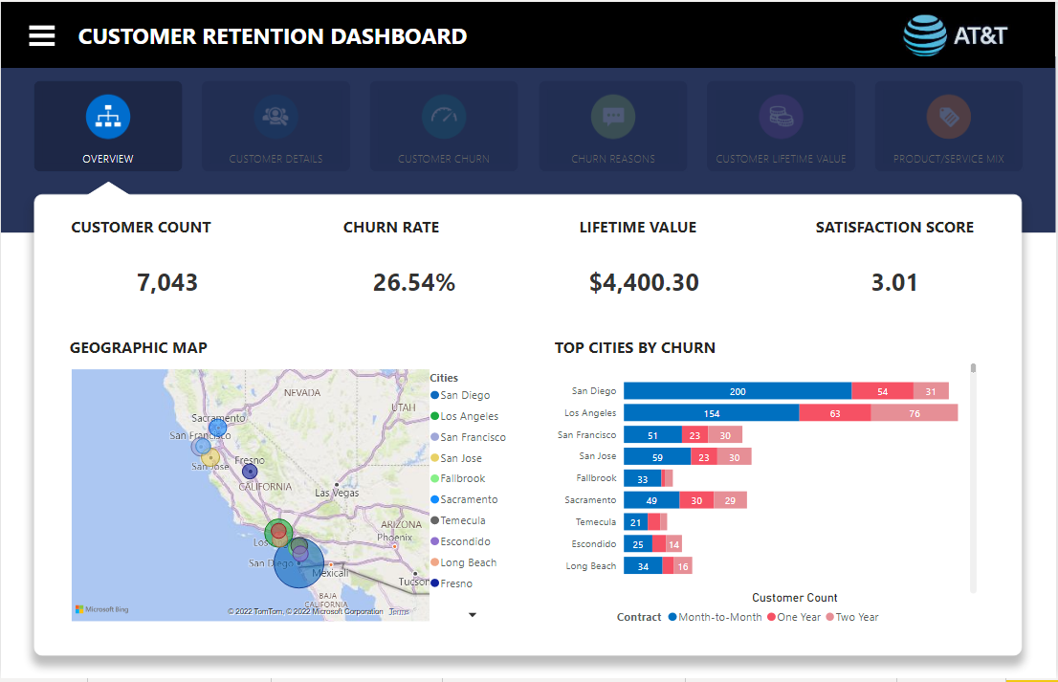
Appendix – Dashboard 1 of 6

Slide 54
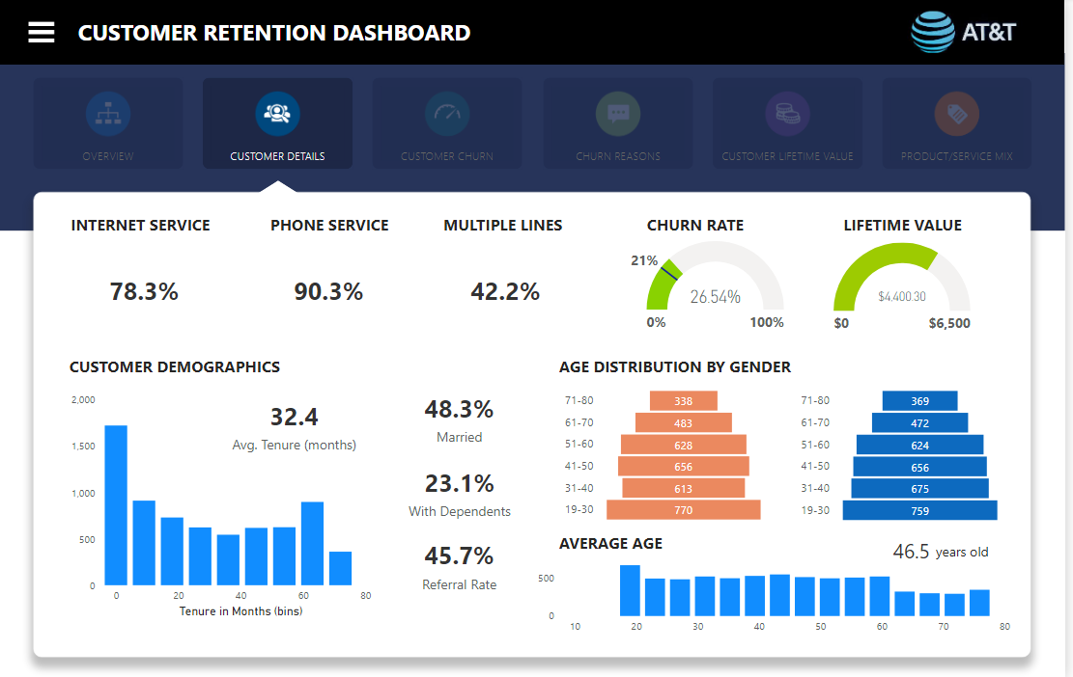
Appendix – Dashboard 2 of 6

Slide 55
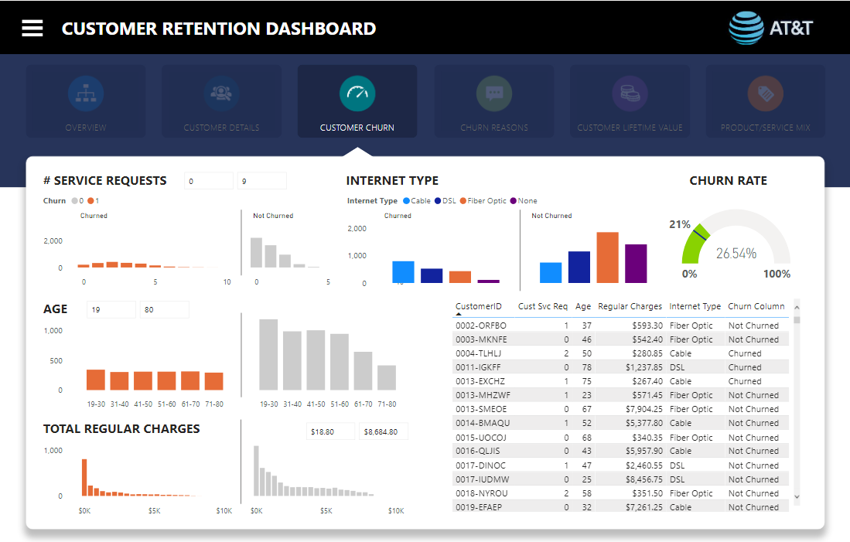
Appendix – Dashboard 3 of 6

Slide 56
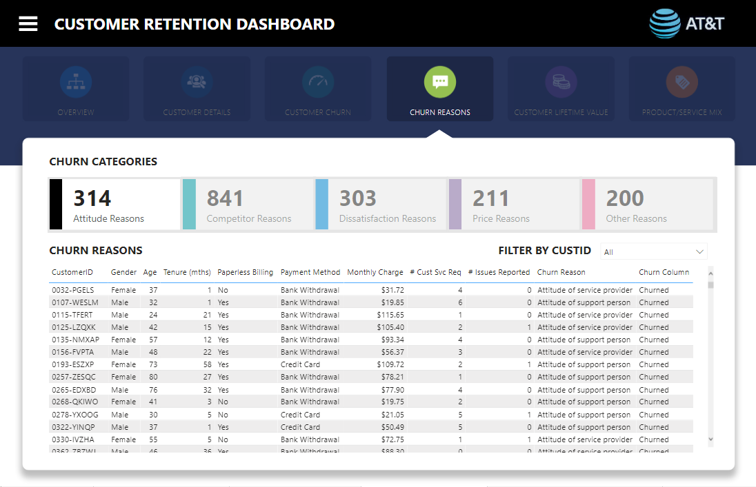
Appendix – Dashboard 4 of 6

Slide 57
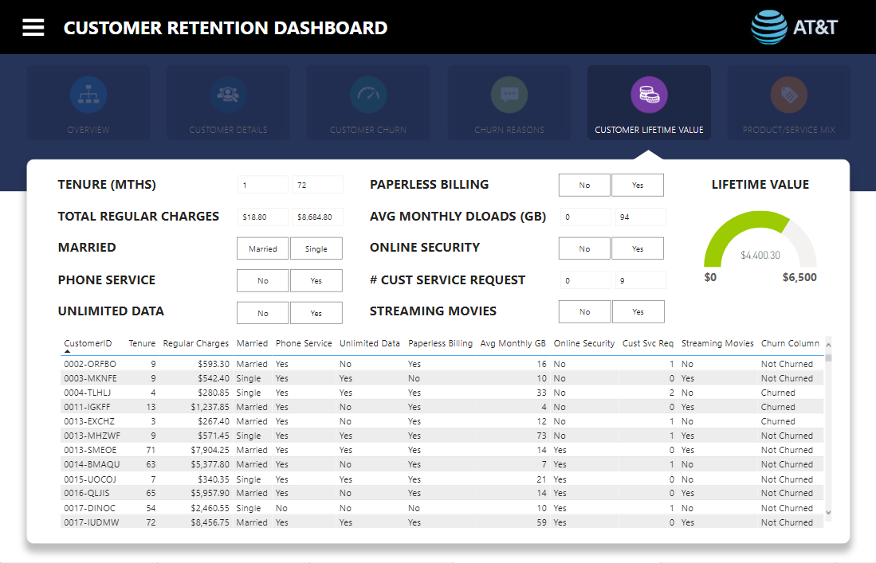
Appendix – Dashboard 5 of 6

Slide 58
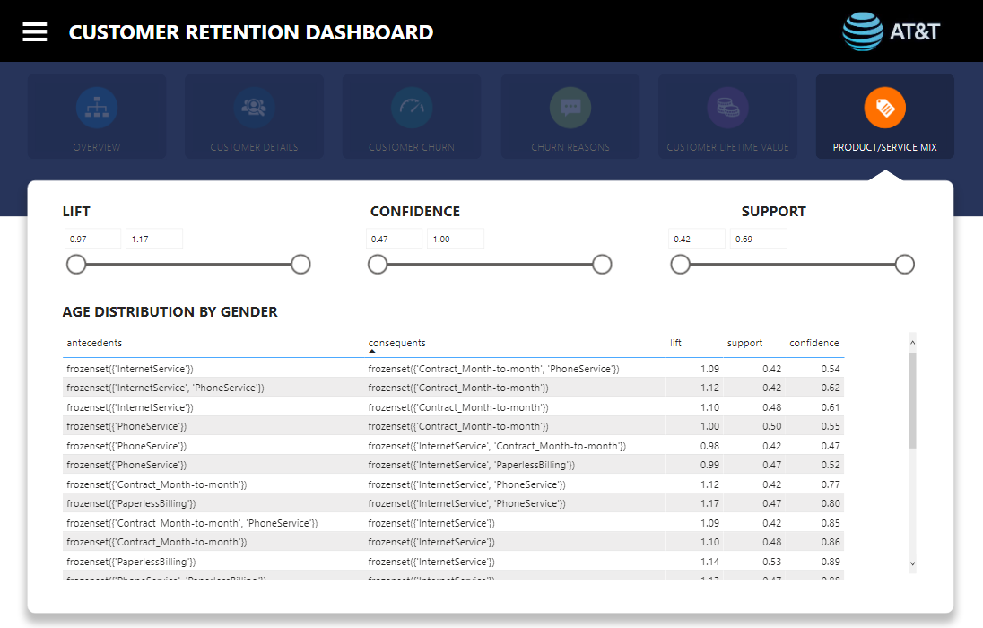
Appendix – Dashboard 6 of 6

